Slide 1
HTTP & APIs

Slide 2
AGENDA
Web Server vs Web Client
Client/Server Model
TCP/IP Suite of Protocols
HTTP Fundamentals
DNS Service
Request / Response
200 vs 404 vs 500 (Common status codes)
API endpoints
Query string params
JSON
Simple node HTTP Client example (live coding exercise)

Slide 3
1. Web Server vs Web Client

Slide 4
1. Web Server vs Web Client

Slide 5
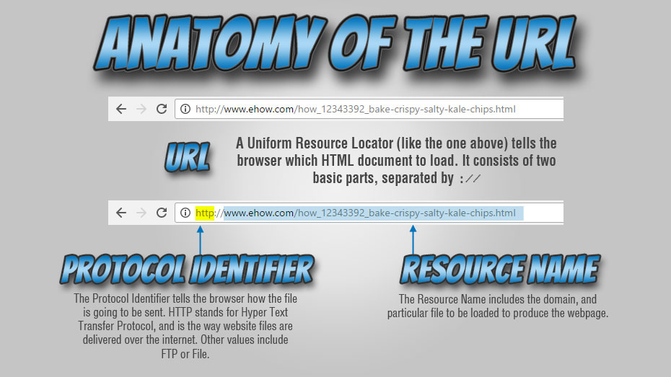
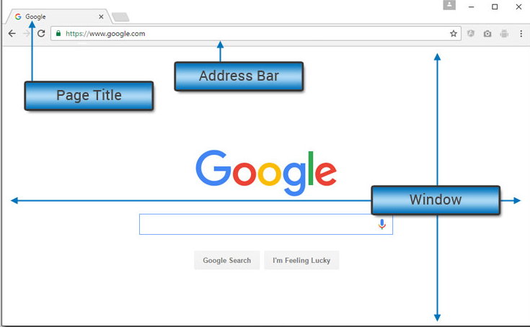

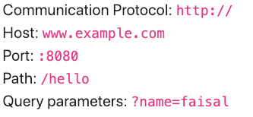
1. Web Server vs Web Client

Slide 6
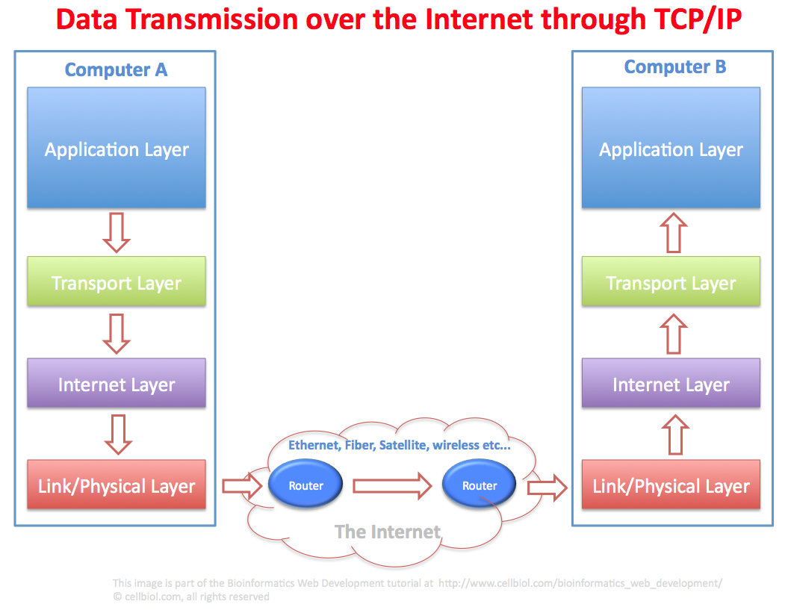
1. Web Server vs Web Client
TCP/IP suite of Protocols

Slide 7
2. HTTP Fundamentals

Slide 8
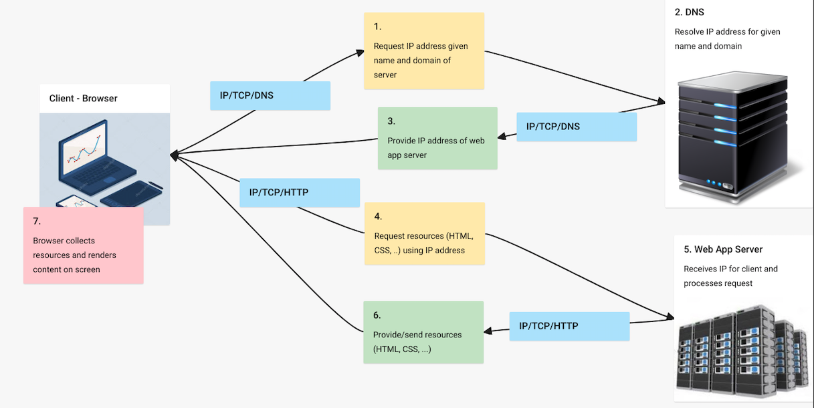
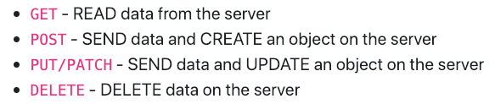

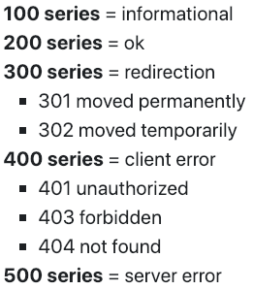
2. HTTP Fundamentals

Slide 9
2. HTTP Fundamentals
API Endpoints

